Slide 1
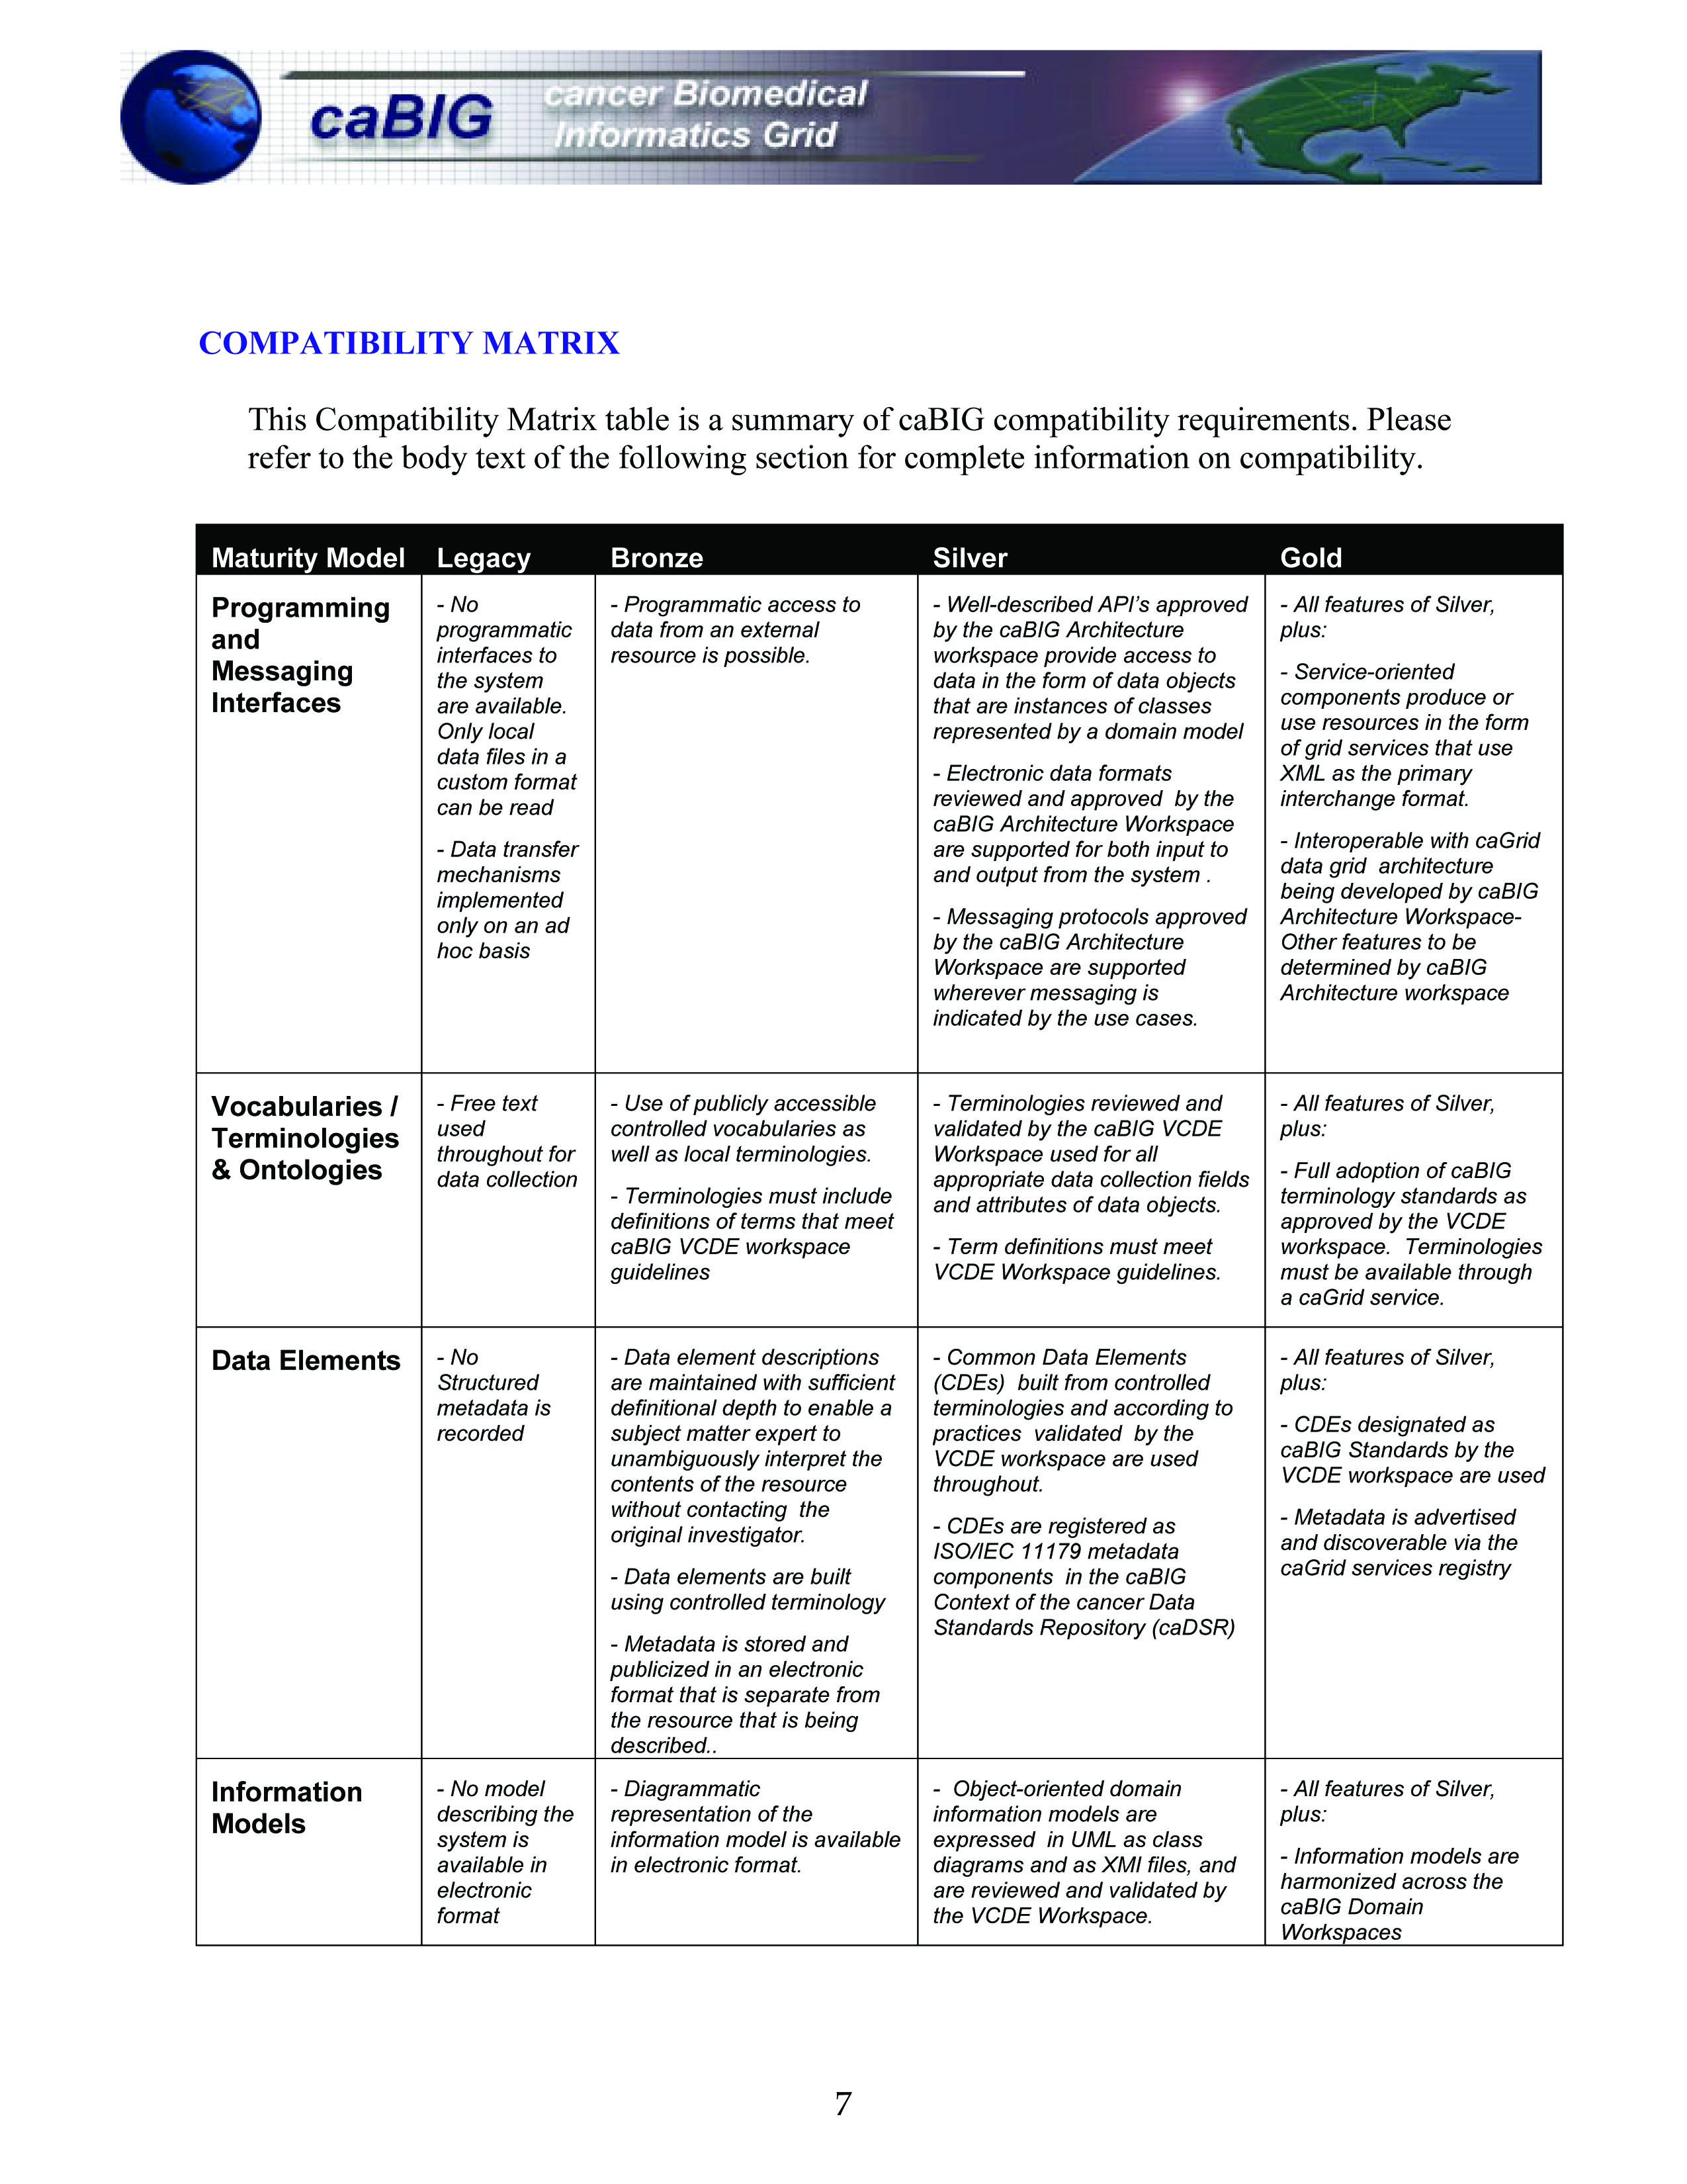
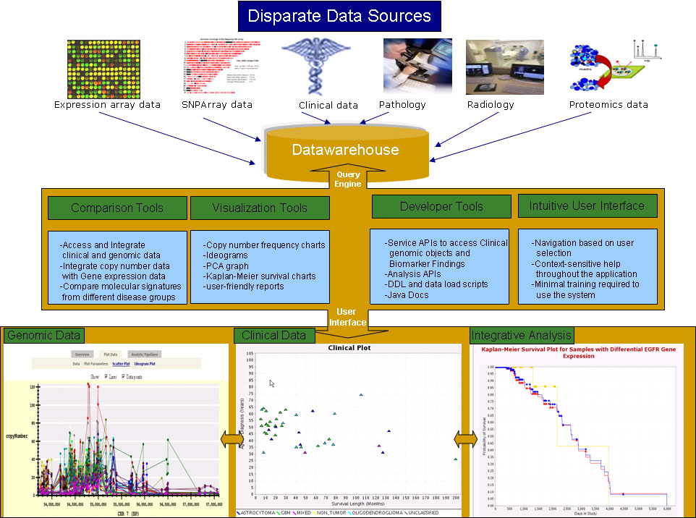








Biomedical Informatics Tools and Resources Provided by the National Cancer Institute Center for Bioinformatics (NCICB) and the cancer Biomedical Informatics Grid TM (caBIGTM)
Mervi Heiskanen and Leslie Derr, NCICB/CBIIT*
Abstract
caIntegrator
caBIGTM –Power of Connection
The NCI Center for Bioinformatics (NCICB) helps speed scientific discovery and facilitates translational research by building many types of tools and resources that enable information to be shared along the continuum from the scientific bench to the clinical bedside and back. NCICB is coordinating NCI’s cancer Biomedical Informatics Grid™ (caBIG™). caBIG™ is a network or grid connecting individuals and institutions to enable the sharing of data and tools, creating a World Wide Web of cancer research. The goal is to speed the delivery of innovative approaches for the prevention and treatment of cancer. The infrastructure and tools created by caBIG™ also have broad utility outside the cancer community. Compatibility with caBIGTM data standards and guidelines facilitates data sharing and integration of diverse data types including clinical, imaging, tissue and functional genomics data. Integrative data analysis is achieved through the interoperability of caBIG-compatible tools, which support the use and exchange of data in a meaningful way. caBIGTM is an open-source, open-access program and everyone in the biomedical research community is welcome to become involved. A wide variety of tools and data are already freely available, and application support and training have been developed to facilitate adoption of these resources.
For more information, please go to http://ncicb.nci.nih.gov/
*Center for BioInformatics and Information Technology, CBIIT
caBIG Goal:
collaborative
information
network
caBIG Principles:
open source,
open access,
open development,
federation
caArray Architecture
caBIG Compatibility Guidelines:
common standards and unifying architecture
ensure interoperability
caCore
caGRID
Integrative Cancer Research Tools
repositories
Gene
Expression
Data
Tissue
Bank
Genome Annotation
PIR
  Cancer Molecular Pages
  Function Express
  GoMiner
  HapMap
  SEED
TrAPSS
Data Analysis and Statistical Tools
Distance-Weighted Discrimination
  Magellan
  VISDA
  Gene Pattern
  caWorkBench
Proteomics
LIMS
  Q5
  RProteomics
Microarrays
caArray
  NCI-60 Data Sharing
  Zebrafish Mircroarray Data
Pathways
Cytoscape/BioPAX/cPath
  QPACA
  Reactome
biomedical objects
cancer Bioinformatics Infrastructure Objects, caBIO
caCORE
- caBIO
- caDSR
- EVS
NCICB
Data Mart
Research
Center
Researcher
Data Mart
Clinical Data
common data elements
cancer Data Standards Repository, caDSR
Data Services
Analytical Services
Annotation Services
Service Advertisement
Service Discovery
Service Query
Semantic mapping
Security Services
Patient
Physician
Gene Expression Data
Proteomics
Data
Clinical Data
Research
Center
Analysis
Tools
controlled vocabulary
Enterprise Vocabulary Services, EVS
Genomics
Data
caGRID is an open, multi-institutional data sharing,
annotation and analysis environment
Cancer Research Services available in caGRID version 1.0:
caArray: data service, NCICB
GenePattern: analytical service, Broad Institute
GeneConnect: data service, Washington University
GridIMAGE: analytical service, Ohio State University
geWorkbench: analytical service, Columbia University
caTRIP: data service, Duke Comprehensive Cancer Center
Bioconductor: analytical service, Fred Hutchinson Cancer Center
Cancer Common Representation Onlologic Environment (caCore):
Enables information integration cross-discipline reasoning

